Slide 1
CASE STUDY HIGHEST PRICED FRUITS & VEGETABLES IN UK FROM 2017-2019

Slide 2
Business questions to be answered
1. Highest priced fruits for each year
2. Highest priced fruits per season
3. Highest priced fruits from 2017-2019.

Slide 3
About the data
1. The data used in the analysis was obtained from kaggle.com
Link to the dataset
https://www.kaggle.com/datasets/datota/fruit-and-vegetable-prices-in-uk-2017-2022
2. The data was received on the 18th of Novemeber, 2022
3. Summary of the data
Name of dataset | No of records | Type of data | No of columns
Fruit and vegetable prices in uk (2017_2019) | 9647 | Multivariate | 6

Slide 4
Cleaning the data
1. Create a column for season using the date column
2. Create a column for month using the date column
Tools used: The cleaning and analysis of the data was done using R programming language

Slide 5
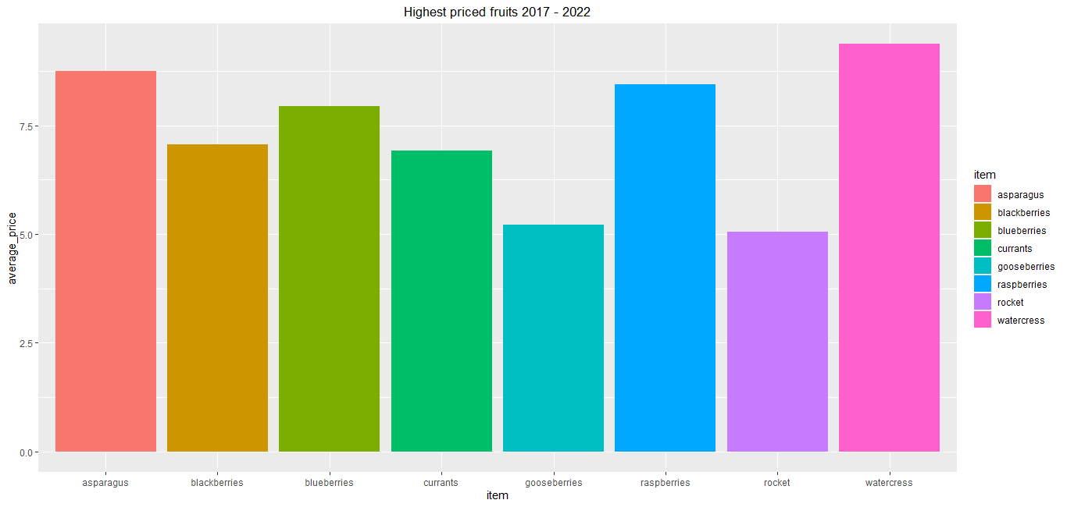
Data analysis insights
DEDUCTION: The highest priced fruits in the years 2017-2019 were
Watercress
Asparagus
Raspberries

Slide 6
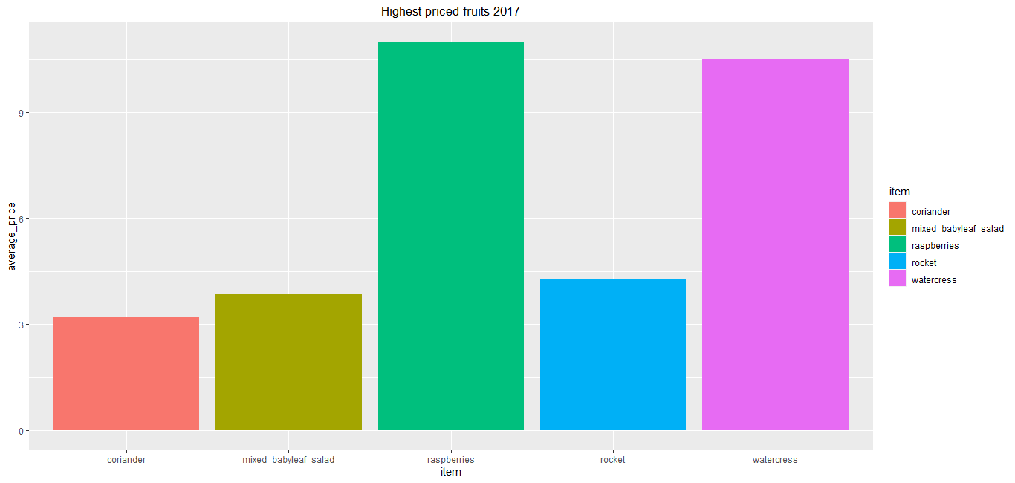
Data analysis insights
DEDUCTION: The highest priced fruits in the years 2017
1.Raspberries
2. Watercress
3. rocket

Slide 7
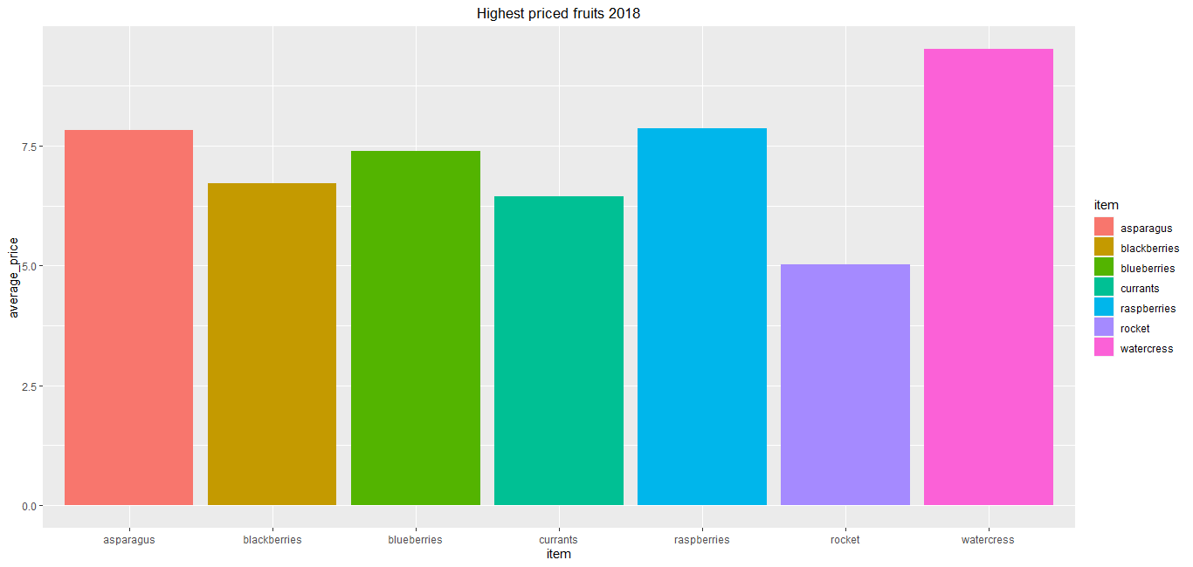
Data analysis insights
DEDUCTION: The highest priced fruits in the years 2018 were
1. Watercress
2. Asparagus
2. Raspberries

Slide 8
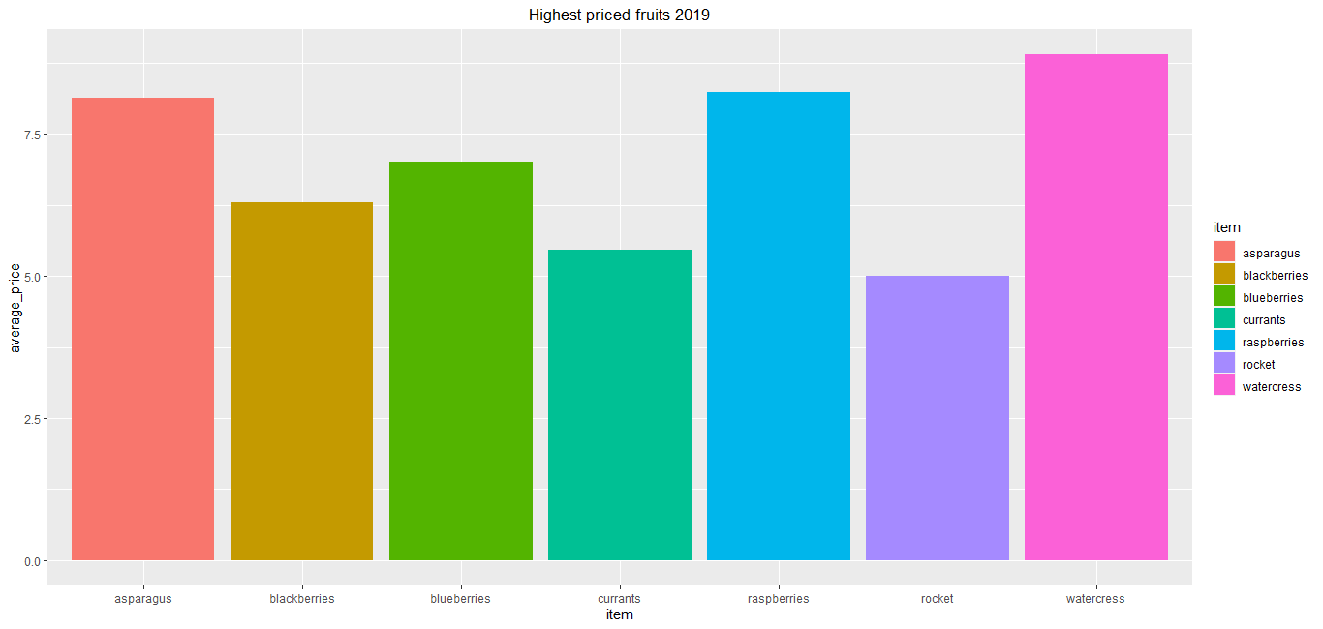
Data analysis insights
DEDUCTION: The highest priced fruits in the years 2019 were
1. Watercress
2. Asparagus
2. Raspberries

Slide 9
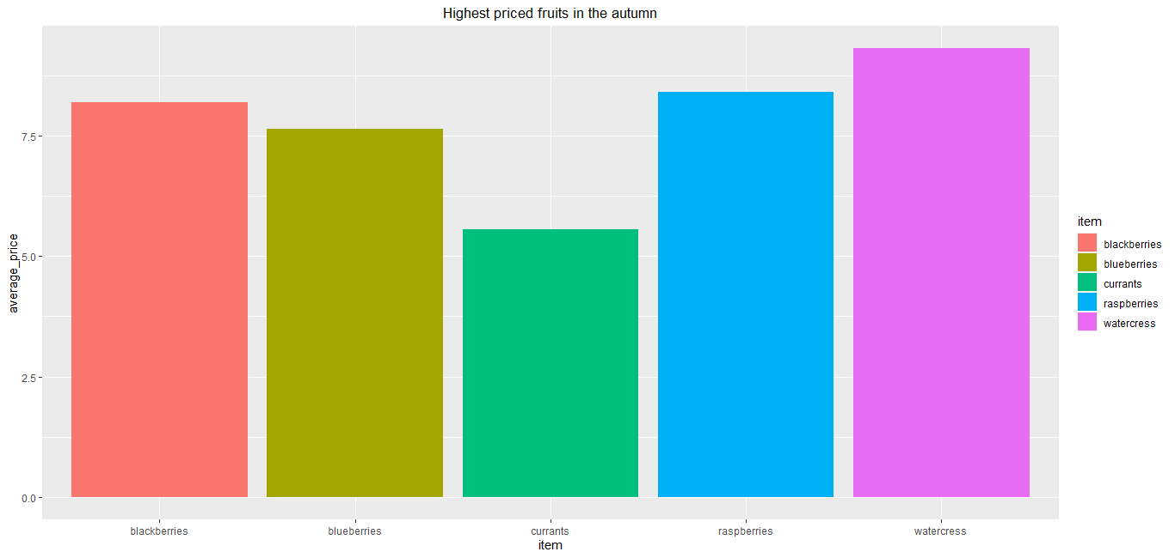
Data analysis insights
DEDUCTION: The highest priced fruits in the autumn were
1. Watercress
2. Raspberries
3. Blackberries

Slide 10
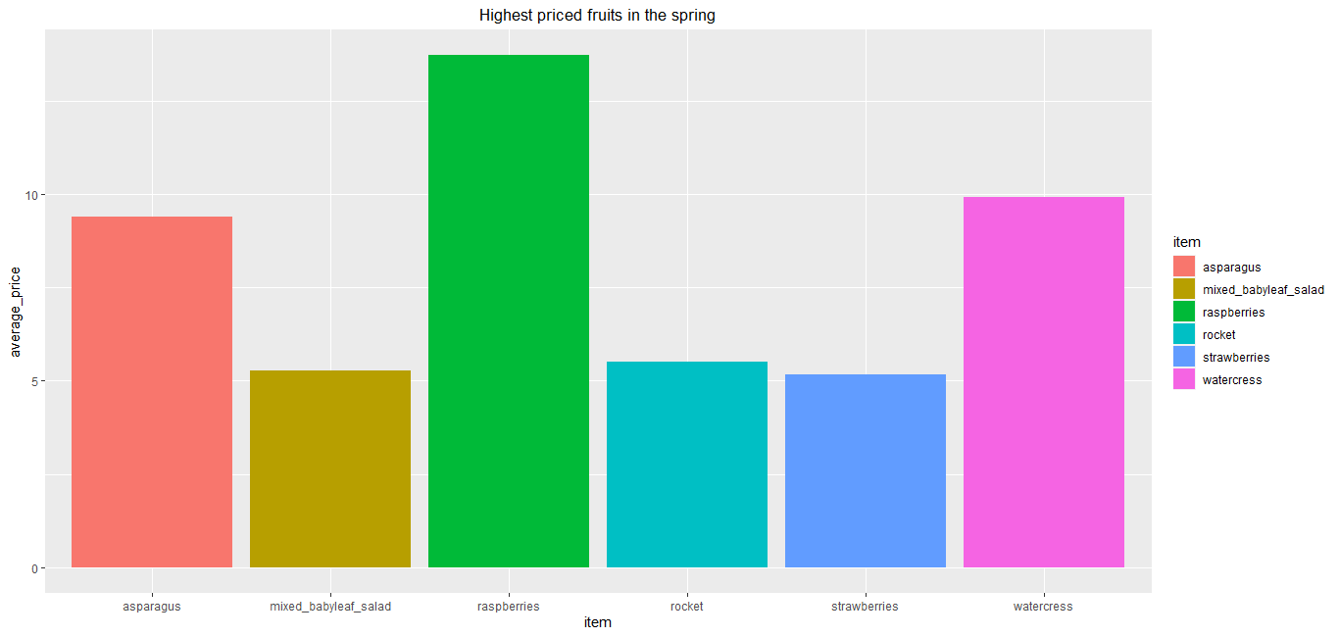
Data analysis insights
DEDUCTION: The highest priced fruits in the spring were
1. Raspberries
2. Watercress
3. Asparagus

Slide 11
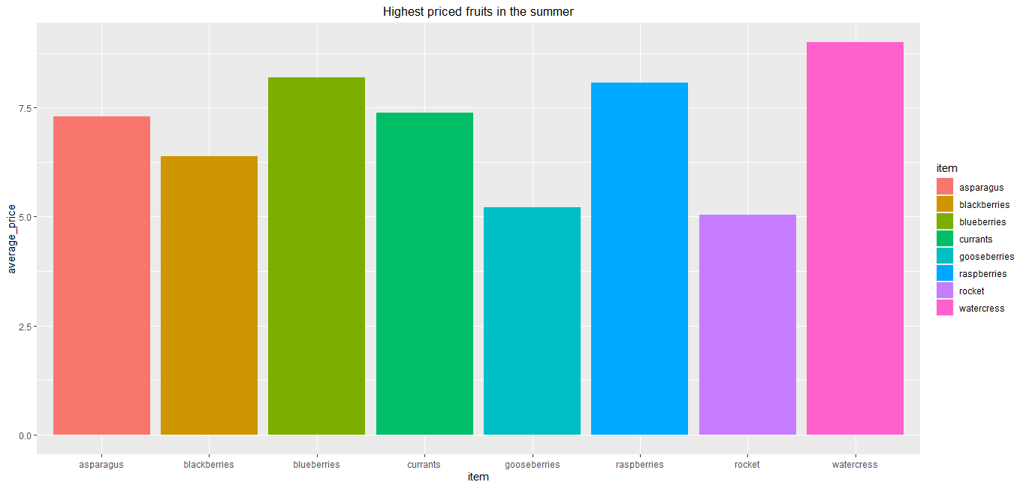
Data analysis insights
DEDUCTION: The highest priced fruits in the summer were
1. Watercress
2. Blueberries
2. Raspberries

Slide 12
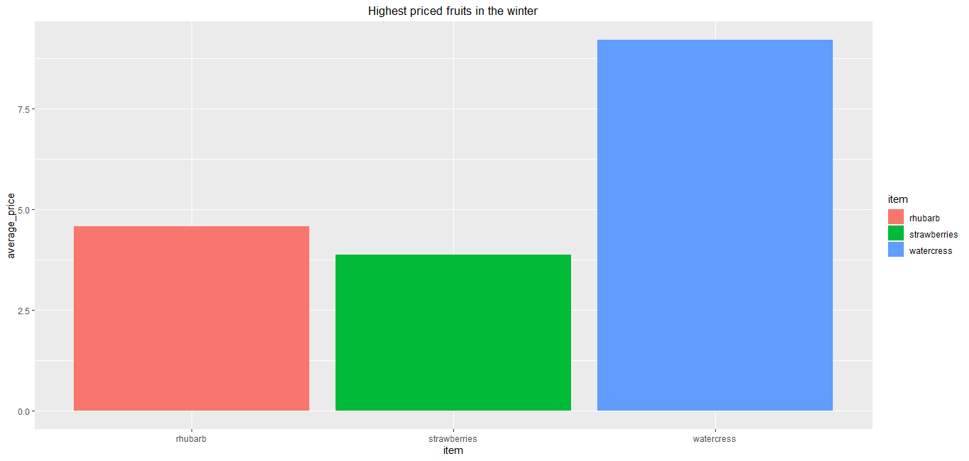
Data analysis insights
DEDUCTION: The highest priced fruits in the winter were
1. Watercress
2. Rhubarb
2. Strawberries

Slide 13
CONCLUSION
1. Watercress vegetable were the highest priced and are highly priced irrespective of the season.
2. Raspberries are highly priced however, their prices drop in the winter

Slide 14
Recommendations
1. I recommend that further analysis be done on the cost of production and demand of both watercress or raspberries to determine which would be most proftitable for a farmer.

Slide 15
THANK YOU

